Slide 1
Database Corruption! Preventing Disaster to your Database
Jeff Mlakar
SQL Saturday #802 – San Diego 2018

Slide 2
Who Am I?
DBA/Developer about 15 years
MS Information Science – University of Pittsburgh
Databases – Security – Privacy
Escalation Engineer – Tech Lead at Varonis
@jmlakar
https://www.linkedin.com/in/jeffmlakar
Blog: www.MlakarTechTalk.com
Notes:
Please contact me with feedback – good or bad

Slide 3
What Will We Learn?
Understanding Database Corruption
Diagnosing Database Corruption
Remediating Database Corruption

Slide 4
Agenda
What is Database Corruption?
How to Diagnose?
What NOT to Do
How to Remediate
Demos

Slide 5
You Need Backups

Slide 6
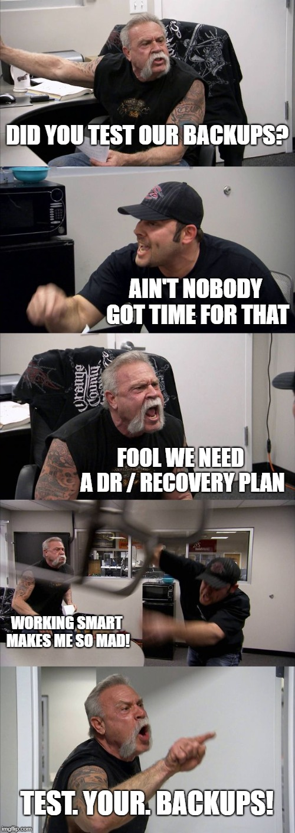
You Need to Test Your Backups

Slide 7
The Scenario
Notes:
Does this look familiar?

Slide 8
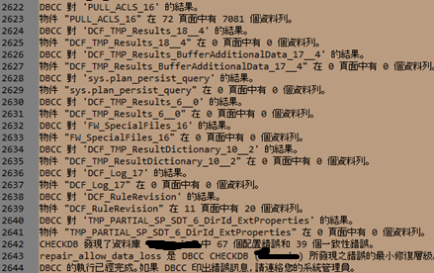
Sometimes it’s all Chinese to me…
Notes:
This was actual output I received once. With so many lines, Google Translate can only take us so far. Corruption can be intimidating but relax and learn how to meet it on the battlefield!

Slide 9
What is Database Corruption?

Slide 10
What is Database Corruption? Baby Don’t Hurt Me?
Data corruption is errors when reading, writing, moving, or processing data
Unintended changes / consistency
When this happens to SQL Server this is called Database Corruption
Cannot be prevented – only dealt with appropriately
Not a matter of if but rather when
Notes:
ACID
CIA model

Slide 11
What Causes Database Corruption
A layer below SQL Server
Most common are hardware faults
The I/O Subsystem
Disks, Controller, CPU, Memory, Network Switch, Cable, SAN, etc.
Platform issues
3rd party drivers or firmware
NTFS file system
Having databases in compressed folders or volumes
Microsoft SQL Server Bug
Evildoers
Notes:
Disks go bad. So do NICs, cables, routers, everything physical. It is not a matter of if but rather when.
Can alter low level database pages, hex editor, etc. to corrupt a database.

Slide 12
Myths to Dispel
Can MyApplication cause corruption? NO
Can running CHECKDB cause corruption? NO
Can creating a database snapshot cause corruption? NO
Can stopping a shrink operation cause corruption? NO
Can stopping an index rebuild operation cause corruption? NO
Notes:
Applications do not cause corruption.

Slide 13
Questions to Ask
How do you know there is corruption?
When did you first notice corruption?
Has the corruption reappeared?
How often does it strike?
Do you notice a pattern in the recurrences?
Is it just 1 database or multiple databases?
Do you have good recent backups?
Notes:
Corruption can be widespread. Backups cannot be trusted by default because they could also be corrupt.

Slide 14
How to Diagnose Database Corruption

Slide 15
Diagnosing Database Corruption
SQL Server Error Logs
Crash Dumps
DBCC CHECKDB
Windows Event Logs
Check the Windows System Event Log for any system level, driver, or disk related errors.
msdb.sys.suspect_pages
Understanding Root Cause
If the RCA is a bad disk then repairing corruption won’t help as the problem will simply happen again once that sector is used
Need to know how widespread the corruption is
Prevent redundant, wasteful, or damaging actions

Slide 16
SQL Server Error Logs
Search for keywords “corrupt”, “severity:”, “error”, “dump”
See references slide for links about SQL Error Log
Error logs cycle each time SQL Server is restarted
Dates of file can help determine which logs to grab

Slide 17
Identifying Corruption in the Error Log
Examples
SQL Server detected a logical consistency-based I/O error: incorrect checksum (expected: 0xfdff74c9; actual: 0xfdff74cb). It occurred during a read of page (1:69965) in database ID 13 at offset 0x0000002229a000 in file 'D:\Develop\Databases\Broken1.mdf'. Attempt to fetch logical page 1:69965 in database 13 failed. It belongs to allocation unit 72057594049069056 not to 281474980642816.
Msg 8946, Level 16, State 12, Line 1 Table error: Allocation page (1:2264640) has invalid PFS_PAGE page header values. Type is 0. Check type, alloc unit ID and page ID on the page. Msg 8998, Level 16, State 2, Line 1 Page errors on the GAM, SGAM, or PFS pages prevent allocation integrity checks in database ID 13 pages from (1:2264640) to (1:2272727)
Msg 8914, Level 16, State 1, Line 1 Incorrect PFS free space information for page (1:26839) in object ID 181575685, index ID 1, partition ID 293374720802816, alloc unit ID 76911687695381 (type LOB data). Expected value 0_PCT_FULL, actual value 100_PCT_FULL.
Msg 824, Level 24, State 2, Line 1 SQL Server detected a logical consistency-based I/O error: incorrect checksum (expected: 0x07e505f0; actual: 0x386c1019). It occurred during a read of page (1:111582) in database ID 6 at offset 0x000000367bc000 in file 'C:\SQLData\AdventureWorks2008R2_Data.mdf'. Additional messages in the SQL Server error log or system event log may provide more detail. This is a severe error condition that threatens database integrity and must be corrected immediately. Complete a full database consistency check (DBCC CHECKDB). This error can be caused by many factors; for more information, see SQL Server Books Online.
Notes:
Severe errors, logical consistency, checksum

Slide 18
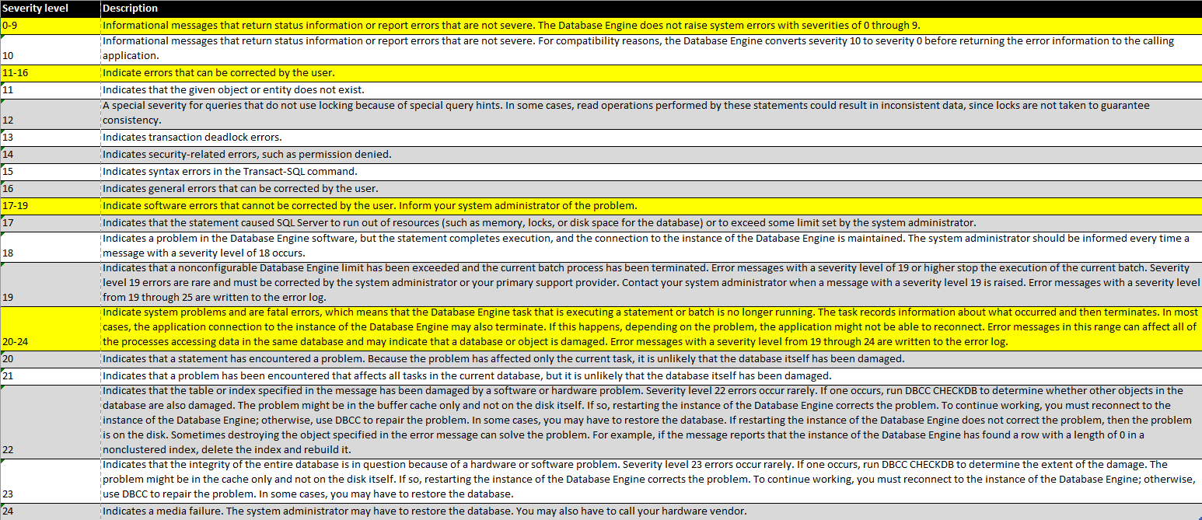
Error Levels of Severity
Notes:
Only concerned about errors with a severity >= 16. Anything >= 20 is very bad. Likely they will have crash dumps.

Slide 19
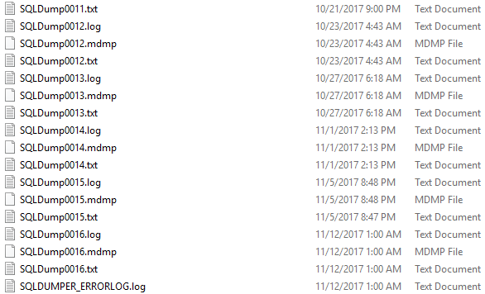
Crash Dumps
Often indicative of either a SQL Server bug or corruption
Will need Microsoft to properly analyze these
Notes:
Crash dumps are a sign that there is database corruption. We cannot do much with them. Need to go to Microsoft. In some cases with strategic / sensitive customers we have taken the files and opened a case with MSFT and followed through.

Slide 20
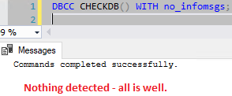
DBCC CHECKDB Usage
DBCC CHECKDB [ ( database_name | database_id | 0 [ , NOINDEX | , { REPAIR_ALLOW_DATA_LOSS | REPAIR_FAST | REPAIR_REBUILD } ] ) ] [ WITH { [ ALL_ERRORMSGS ] [ , EXTENDED_LOGICAL_CHECKS ] [ , NO_INFOMSGS ] [ , TABLOCK ] [ , ESTIMATEONLY ] [ , { PHYSICAL_ONLY | DATA_PURITY } ] [ , MAXDOP = number_of_processors ] } ] ]
DBCC CHECKDB() with no_infomsgs
Cursor / programmatic
Notes:
See link in references for more details.

Slide 21
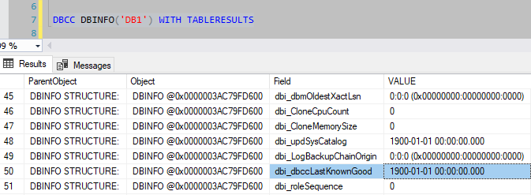
CHECKDB – Last Runtime
DBCC DBINFO will show the date time stamp in Field column
Notes:
1900.01.01 means never run. Executing CHECKDB will populate this field.

Slide 22
CHECKDB Output
Scroll to the bottom and look for summary line
Tells us if there is any corruption
Reliable but not 100% foolproof.
Ideally run on every database on the SQL Instance
Can exclude tempdb
Examples
Notes:
This tells us if CHECKDB detected any inconsistencies. It’s pretty good but note that it isn’t foolproof and will miss corruption in rare instances.

Slide 23
sys.suspect_pages
Indicates possible bad pages…they are suspected
Used for errors 823 and 824 – high severity bad disk errors
Updated during a restore, DBCC repair, or drop database command
Supplemental to the SQL Error Log and CHECKDB output
Some shops alert on activity in this table
Notes:
This is supplemental and ancillary. Typically don’t need to dig into this. SQL Error Log and CHECKDB give same (and more) results.

Slide 24
Database States
3 states a DB can be in
Online – all is well…happy path
Recovery pending – something is preventing the database from starting up
Suspect – transaction log is damaged
Can happen when a DB isn’t shut down properly or a rollback tries to read a corrupt page
Might have to rebuild transaction log
Emergency Mode
Used to try and get a database back online
Makes DB read-only, logging is disabled, limited rights.
Requires sysadmin
Notes:
Rebuilding xact log – involves some DB trickery. Need to create a new database and swap files.

Slide 25
Changing Database States
ALTER DATABASE AdventureWorks2016 SET SINGLE_USER WITH ROLLBACK IMMEDIATE;
ALTER DATABASE AdventureWorks2016 SET OFFLINE WITH NO_WAIT;
ALTER DATABASE AdventureWorks2016 SET EMERGENCY;
ALTER DATABASE AdventureWorks2016 SET ONLINE;
ALTER DATABASE AdventureWorks2016 SET MULTI_USER;

Slide 26
Warning! What Not To Do

Slide 27
Danger! Do Not Do!
Don’t Panic
Don’t Detach the Database
Don’t Restart SQL Services
Don’t Reboot the Machine
Don’t Start by Trying to Repair the Corruption
Don’t
Notes:
We need to understand the root cause so that we don’t perform useless or harmful actions.

Slide 28
Remediation: Fixing the Corruption

Slide 29
General Remediation Warning
There are no guarantees with corruption!
There Will May Be Blood Data Loss
Notes:
Backups are key to dealing with corruption. If they have a good backup that is recent it is almost always a better option than trying to repair corruption.

Slide 30
Preliminary Actions
Stop any backups against known corrupt databases
Stop any backup deletion jobs
If there is recent CHECKDB output then review it
Notes:
Engage in dialogue

Slide 31
Backups…backups…backups…
Restoring a backup is better than all the other options

Slide 32
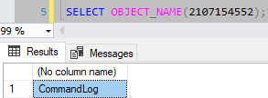
Attempts to Resolve
Restoring a backup is better than all the other options
Need CHECKDB output
Output is per database so we know which one
Object ID tells us which object is corrupted
System tables
If system tables are damaged we cannot fix them.
Only Microsoft can possibly help here. Need to rebuild the database.
Notes:
Sometimes we get lucky with indexes.
If the corruption is on a nonclustered index then it can simply be dropped and recreated.
If the corruption is on a clustered index then the whole table is lost. Will have to recreate definition and possibly populate data.

Slide 33
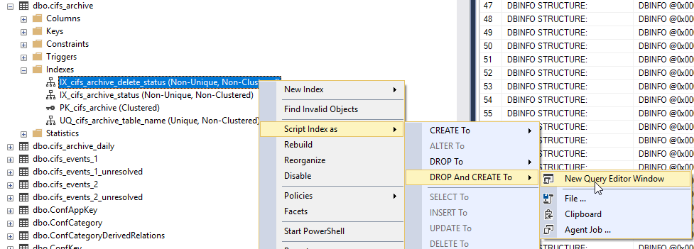
Fixing Indexes
Clustered indexes
This represents the actual physical table – will need to rebuild table
Nonclustered indexes
Index can be dropped and recreated (NOT ALTER)
Can repair using REPAIR_REBUILD
Can use sys.indexes, sys.objects to learn about the object
Notes:
Sometimes we get lucky – these are typically somewhat easy to fix.

Slide 34
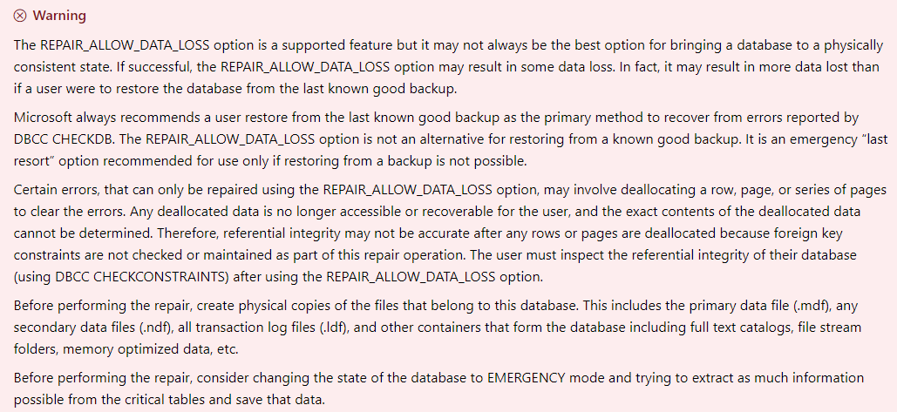
Repair Option
This is a last resort before we destroy and rebuild
Restoring from a backup is better and usually less data loss
DBCC CHECKDB('MyDB') WITH REPAIR_ALLOW_DATA_LOSS;
Attempts to repair all errors
Will most certainly result in some kind of data loss.
Notes:
Repair will deallocate database pages – this is why data loss is a certainty.

Slide 35
Aftermath
Patch SQL Server - Get on the current SP / CU build
Run CHECKDB every night for a while
Keep backups for longer if short retention cycle
Alert for errors 823, 824, 825
Turn on page verification for databases
aka page verification checksum, DB option
Default is checksum unless they change it
Take backups with checksum
Restore backups and run consistency check
Different instance vs Renaming the restored database name
Storage team patch and review errors
Checkdisk
Vendor specific diagnostic utilities for the disks
Update drivers and firmware

Slide 36
Simple Checklist
Procure and analyze SQL Error Log and CHECKDB output
Determine the impact of corruption
Try to restore a backup – if none then continue on
Try to resolve corruption based on previous slides
Take steps in the Aftermath slide to prevent future corruption

Slide 37
Remediation Beyond Our Scope
Microsoft Support – open a support case
Advanced Restore Techniques
Log File Corruption
Corruption Specialist
Data Recovery Specialist
Notes:
Like Cloakman, database corruption is a serious and dangerous matter. Don’t mess with it.

Slide 38
Reference Material
https://blogs.msdn.microsoft.com/suhde/2009/04/08/database-corruption-part-1-introduction-to-database-corruption-in-sql-server/
https://www.brentozar.com/archive/2016/05/dbcc-checkdb-reports-corruption/
http://www.sqlservercentral.com/articles/Corruption/65804/
https://www.sqlskills.com/blogs/paul/search-engine-qa-26-myths-around-causing-corruption/
https://docs.microsoft.com/en-us/sql/t-sql/database-console-commands/dbcc-checkdb-transact-sql
https://docs.microsoft.com/en-us/sql/relational-databases/errors-events/database-engine-error-severities
https://docs.microsoft.com/en-us/sql/tools/configuration-manager/viewing-the-sql-server-error-log
https://docs.microsoft.com/en-us/sql/relational-databases/performance/view-the-sql-server-error-log-sql-server-management-studio
Notes:
Anything by Paul Randal – he literally wrote DBCC commands and some key parts of the SQL Server data engine.

Slide 39
Demos
Corrupting a Database
HEXED! Corrupting a database with a hex editor
Corrupting a DB with DBCC WRITEPAGE
DBCC WRITEPAGE! Corrupting and repairing a nonclustered index
Corruption with lost transaction log
Emergency Mode! Try to get in and fix
We Examine:
Examining output from CHECKDB
SQL Error Log
sys.databases / sys.master_files
Emergency Mode / Single User Mode
Repairing via CHECKDB
Detaching and Attaching a DB
DBCC WRITEPAGE / DBCC IND
Notes:
Anything by Paul Randal – he literally wrote DBCC commands and some key parts of the SQL Server data engine.

Slide 40
Thank You! Q&A @jmlakar https://www.linkedin.com/in/jeffmlakar/ www.MlakarTechTalk.com

